Slide 1
FOOD
NAWAMWENA NAZIFA

Slide 2
Importance of food
Mental stability
Growth and development
To get energy
To be healthy

Slide 3
Types of food
Flied fish
Matooke
Rice
Yams
Chicken
cassava

Slide 4
Difference between matooke and rice
matooke
rice
It is cheap
Easy to prepare
Provides protein
It is expensive
Hard to prepare
Provides carbohydrates

Slide 5
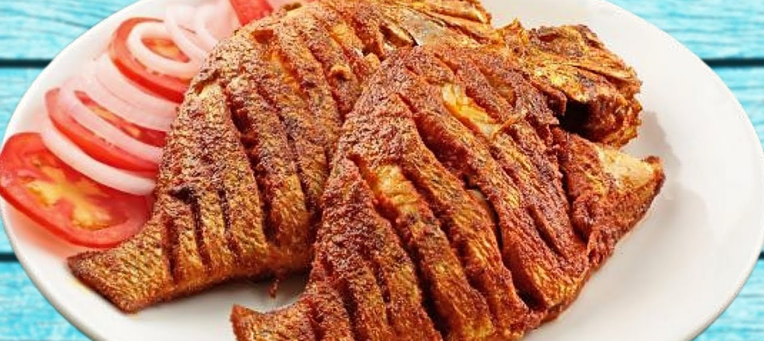
Favorite food
Flied fish

Slide 6
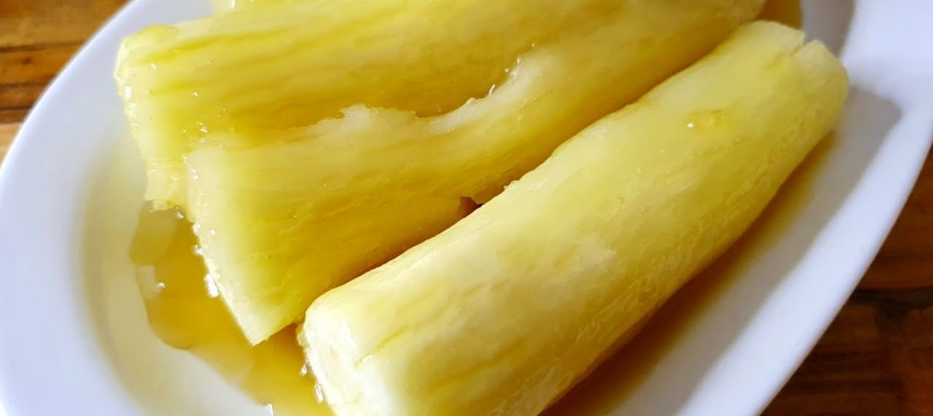
My worst food
cassava

